Slide 1
The Google File System Sanjay Ghemawat, Howard Gobioff, and Shun-Tak Leung Google SOSP’03, October 19–22, 2003, New York, USA
Hyeon-Gyu Lee, and Yeong-Jae Woo
Memory & Storage Architecture Lab.
School of Computer Science and Engineering
Seoul National University
Notes:
1

Slide 2
Outline
Design overview
Assumptions
Interface
Architecture
Single master
Chunk size
Metadata
Consistency model
System interactions
Master operation
Fault tolerance
Measurements
Conclusion

Slide 3
Assumptions
The system is built from many inexpensive commodity components
The system stores a modest number of large files
A few million files, each typically 100 MB or larger
The workloads primarily consist of
Large sequential reads and small random reads
Large sequential writes that append data to files
The system must efficiently implement semantics for clients that concurrently append to the same file
High sustained bandwidth is more important than low latency
Notes:
Very specialized file system for Google.

Slide 4
Interface
Files are organized in directories and identified by pathnames
File operations
Create, delete, open, close, read, and write
Snapshot
Creates a copy of a file or a directory tree
Record append
Allows multiple clients to append data to the same file concurrently while guaranteeing the atomicity
Notes:
Append operation is cared especially because it is the most common operation in GFS.

Slide 5
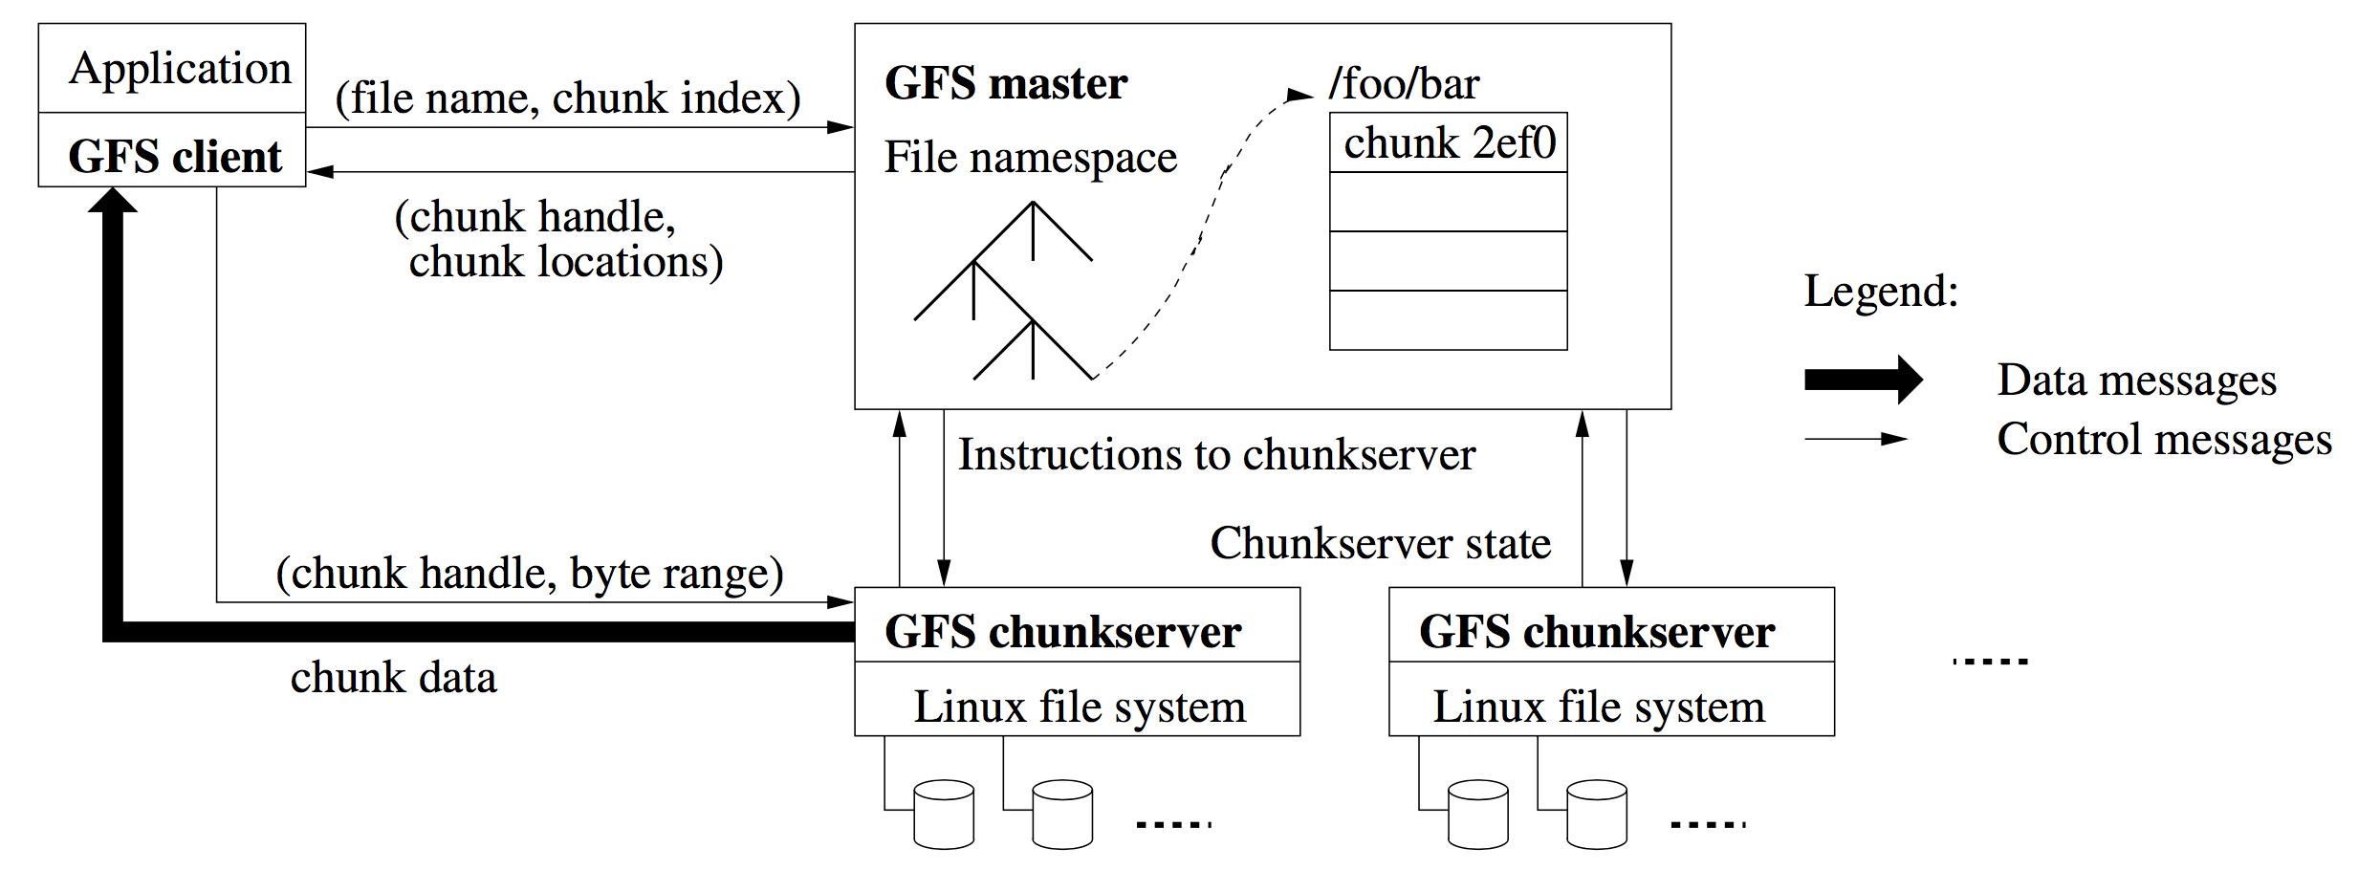
Architecture
A GFS cluster consists of a single master and multiple chunkservers
Files are divided into fixed-size chunks
Master maintains all file system metadata
Neither the client nor the chunkserver caches file data
Notes:
All of user data is accessed directly from chunkserver, not touching master.

Slide 6
Architecture
A GFS cluster consists of a single master and multiple chunkservers
Files are divided into fixed-size chunks
Each chunk is identified by an immutable and globally unique 64 bit chunk handle
Master maintains all file system metadata
Namespace, access control information, mapping from files to chunks, and current locations of chunks
Master periodically communicates with each chunkserver in HeartBeat messages
Neither the client nor the chunkserver caches file data

Slide 7
Single master
Master makes chunk placement and replication decisions
Client asks the master which chunkserver it should contact
Client caches this information and interacts with the chunkserver directly
1
2
3
4

Slide 8
Chunk size
Large chunk size (64 MB)
Pros
Reduces clients’ need to interact with the master
Reduces network overhead since client is likely to perform many operations on a large chunk
Reduces the size of the metadata stored on the master
Cons
If many clients are accessing the same small file, chunkservers may become hot spots
Ex) an executable single-chunk file
Sol) Stores such files with a higher replication factor

Slide 9
Metadata
Metadata types (stored in memory)
File and chunk namespaces
Mapping from files to chunks
Locations of each chunk’s replicas
Master periodically scans its entire state in background
For chunk garbage collection, re-replication, and chunk migration
Size of metadata is not a problem
Master maintains < 64 B of metadata for each 64 MB chunk
File namespace data requires < 64 B per file name
Operation log contains a record of metadata changes
Also provides a logical time line that defines the order of concurrent operations
Changes are not visible to clients until metadata changes are made persistent
Master recovers its state by replaying the operation log from last checkpoint
Be kept persistent by logging to an operation log
Rebuild by asking each chunkserver

Slide 10
Consistency model
GFS has a relaxed consistency model
Guarantees by GFS
File namespace mutations are atomic and are handled in master with locking
File region state after mutation
Implications for applications
Applications deal with the relaxed consistency model by using appends, checkpointing, and writing self-validating, self-identifying records

Slide 11
Outline
Design overview
System interactions
Leases and mutation order
Data flow
Atomic record appends
Snapshot
Master operation
Fault tolerance
Measurements
Conclusion

Slide 12
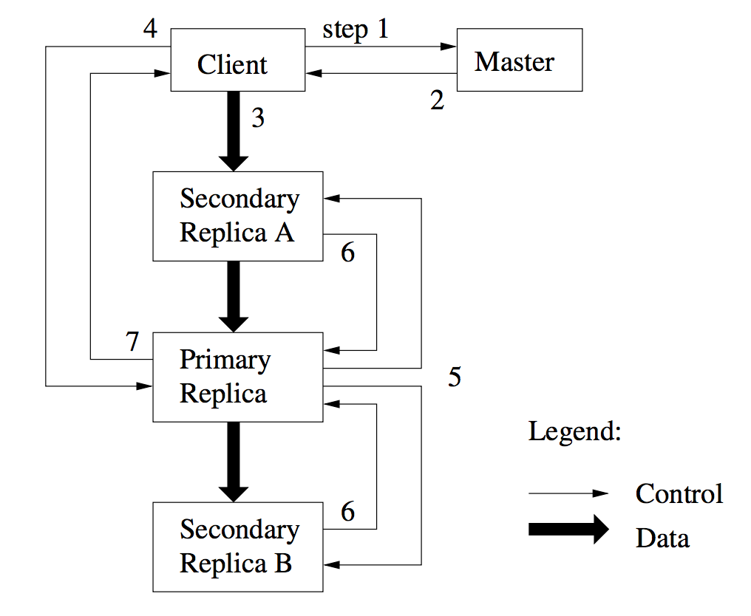
Leases and mutation order
Mutation is performed at all chunk’s replicas using leases to maintain a consistent mutation order across replicas
Master grants a chunk lease to one of the replicas, called primary
Primary picks a serial order for all mutations to the chunk
Notes:
Maintaining replicas to specified number for reliability is needed.

Slide 13
Data flow
GFS decouples the data flow from the control flow
Each machine forwards the data to the “closest” machine in the network topology that has not received it
Distances can be estimated from IP addresses
GFS minimizes the latency by pipelining the data transfer over TCP connections

Slide 14
Atomic record appends
GFS appends the data to the file at least once atomically at an offset of GFS’s choosing and returns that offset to the client
Algorithm of atomic record append
Client pushes the data to all replicas of the last chunk of the file
Client sends the append request to the primary
Primary checks to see if data causes chunk to exceed the maximum size
If so, pads chunk to the maximum size and tells secondaries to do same, then tells client to retry on the next chunk
If the record fits, primary appends data to its replica, tells secondaries to write at the exact offset where it has

Slide 15
Snapshot
Snapshot operation makes a copy of a file or a directory tree almost instantaneously
GFS uses copy-on-write technique to implement snapshots
Revokes any outstanding leases on the chunks to snapshot
Logs the snapshot operation to disk and duplicates the metadata
If a client wants to write, creates a new chunk and tells secondaries to do same

Slide 16
Outline
Design overview
System interactions
Master operation
Namespace management and locking
Replicas
Garbage collection
Fault tolerance
Measurements
Conclusion

Slide 17
Namespace management and locking
GFS allows multiple operations to be active and uses locks to ensure serialization
Namespace is represented as a lookup table mapping full pathnames to metadata
Represented as a tree in memory with prefix compression
Each node has an associated read-write lock and each master operation acquires locks before it runs
Locks are acquired in a total order to prevent deadlock
Ordered by level in the namespace tree and lexicographically in the same level

Slide 18
Replicas
GFS spreads chunk replicas across racks
This ensures that some replicas will survive even if an entire rack is damaged
This can exploit the aggregate bandwidth of multiple racks
Replicas are created for chunk creation, re-replication, and rebalancing
Places new replicas on chunkservers with below-average disk space utilization
Re-replicates a chunk when the number of available replicas falls below a user-specified goal
Rebalances replicas periodically for better disk space and load balancing

Slide 19
Garbage collection
GFS reclaims the storage for deleted files lazily via garbage collection at the file and chunk levels
File level
When a file is deleted, master logs the deletion and renames the file to a hidden name that includes the deletion timestamp
During the master’s scan, hidden files are removed if they have existed for more than 3 days
Chunk level
Each chunkserver reports a subset of chunks it has and master identifies and replies with orphaned chunks
Each chunkserver deletes orphaned chunks

Slide 20
Outline
Design overview
System interactions
Master operation
Fault tolerance
High availability
Data integrity
Measurements
Conclusion

Slide 21
High availability
Fast recovery
Master and chunkserver are designed to restore their state and start in seconds
Chunk replication
Each chunk is replicated on multiple chunkservers on different racks
Users can specify different replication levels
The default is 3
Master replication
Operation logs and checkpoints are replicated on multiple machines
One master process is in charge of all mutations and background activities
Shadow masters provide read-only access to the file system when the primary master is down

Slide 22
Data integrity
Each chunkserver uses checksumming to detect data corruption
A chunk is broken up into 64 KB blocks
Each block has a corresponding 32 bit checksum
Chunkserver verifies the checksum of data blocks for reads
During idle period, chunkservers scan and verify the inactive chunks

Slide 23
Outline
Design overview
System interactions
Master operation
Fault tolerance
Measurements
Micro-benchmarks
Real world clusters
Conclusion

Slide 24
Micro-benchmarks
Test environment
GFS cluster consists of 1 master with 2 replicas, 16 chunkservers, and 16 clients
Each machine
Dual 1.4 GHz PIII processor
2 GB memory
2 * 80 GB 5400 RPM HDD
100 Mbps full-duplex Ethernet
Replica
Chunkserver #0
Client #0
Master
…
…
Replica
Chunkserver #15
Client #15

Slide 25
Micro-benchmarks
Reads
Each client reads a randomly selected 4 MB * 256 from a 320 GB file
Writes
Each client writes 1 GB data to a new file in a series of 1 MB writes
Each write involves 3 different replicas
Record appends
All clients append simultaneously to a single file

Slide 26
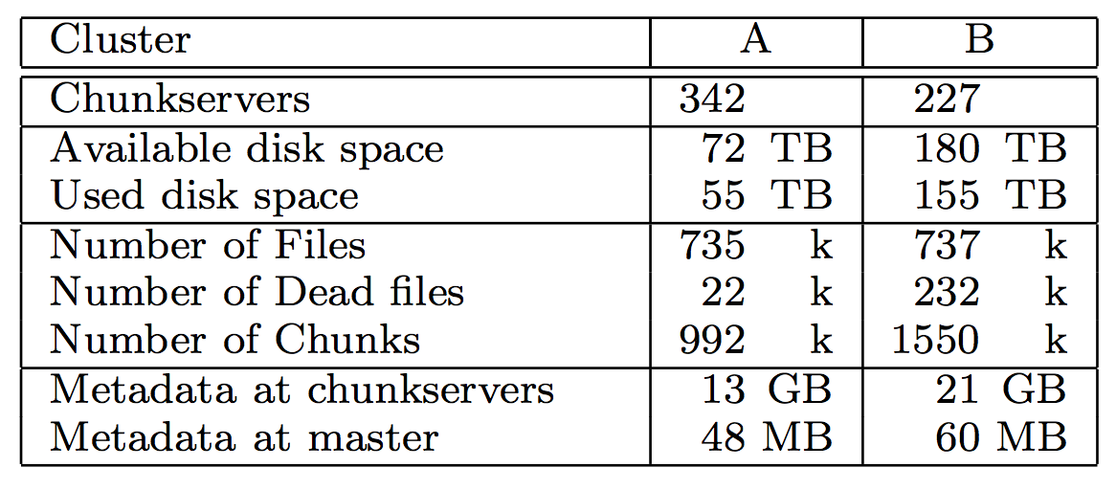
Read world clusters
Test environment
Cluster A
Used for research and development
Reads MBs ~ TBs data and writes the results back
Cluster B
Used for production data processing
Generates and processes TBs data

Slide 27
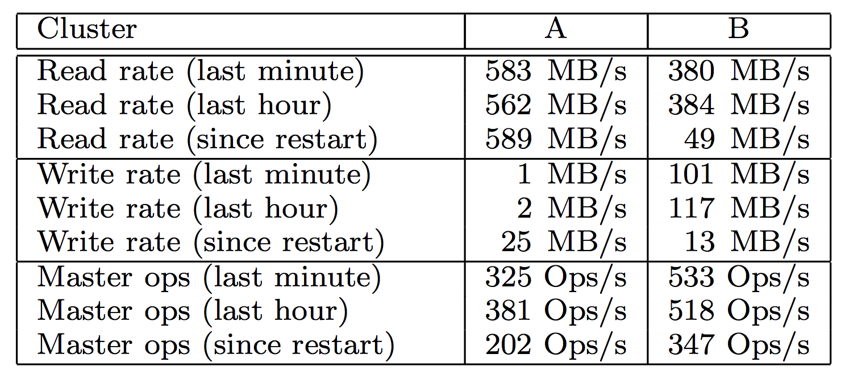
Read world clusters
Performance metrics for two GFS clusters
Cluster B was in the middle of a burst write activity
The read rates were much higher than the write rates
Recovery time
Killed a single chunkserver of cluster B
Which had 15 K chunks containing 600 GB data
All chunks were restored in 23.3 minutes

Slide 28
Outline
Design overview
System interactions
Master operation
Fault tolerance
Measurements
Conclusion

Slide 29
Conclusion
GFS treats component failures as the norm rather than the exception
GFS optimizes for huge files that are appended to and then read
GFS provides fault tolerance by replication and fast recovery
Replication to tolerate against chunkserver failures
Checksumming to detect data corruption
GFS delivers high throughput to many concurrent clients
By separating file system control from data transfer
Master involvement in common operation is minimized
By a large chunk size
By chunk leases
GFS is widely used within Google as the storage platform

